Slide 1


Squiggly Careers®
Company Toolkit
How to create a culture where people can own their development and personalise their progression

Slide 2

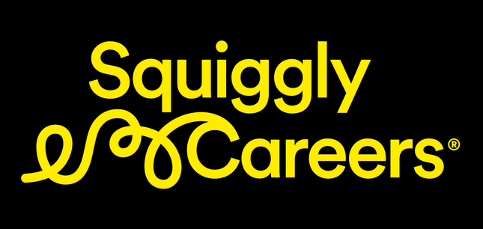
Squiggly Careers Company Toolkit
What is a
squiggly career?

Slide 3
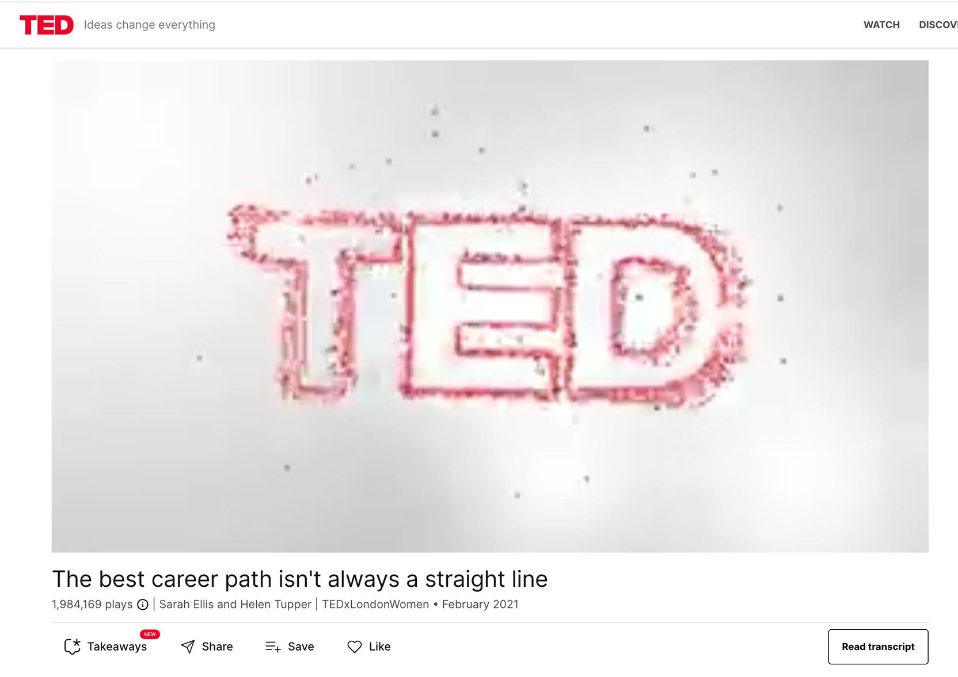
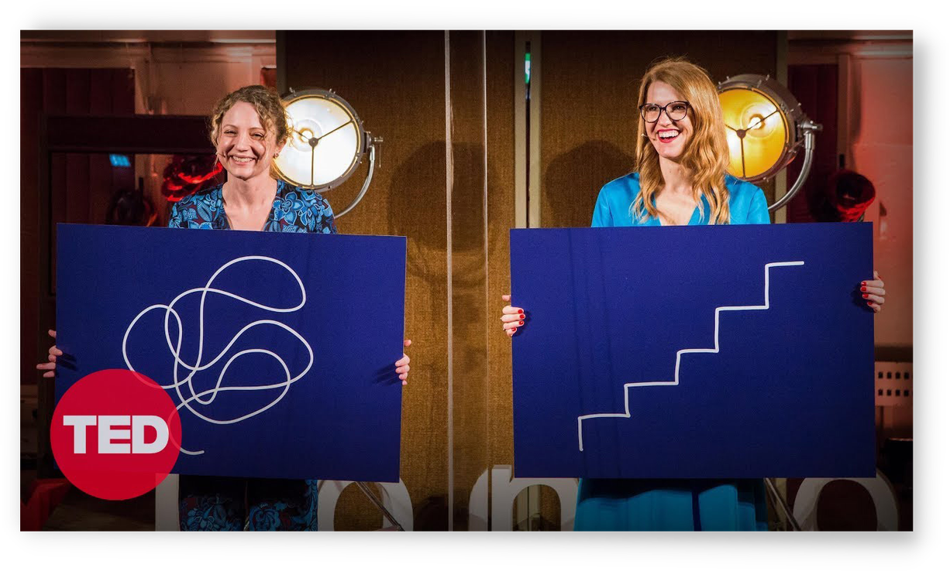
What is a squiggly career?
Careers used to be linear and ladder-like.
They were about following in other people’s footsteps, and focused on getting to the top. Learning was limited by level. You didn’t need to curious about
your own career beyond taking the next step.
This approach is no longer fit for purpose.
It doesn’t reflect people’s reality or their individuality. Today our careers are characterised by change and choices, by potential and possibilities. Climbing the ladder step-by-step has been replaced by something more ‘squiggly’.
A squiggly career is all about learning, growth,
and possibility.
Squiggly careers give people the freedom and flexibility to develop in the direction that is right for them. It helps people’s skills to stay relevant and means that their careers are more resilient to change.

Slide 4


How careers have changed
From Staircases to Squiggles
How careers have changed
Past
Present

Slide 5

The words we use shape how we see our careers
Ladder-like language
Squiggly swaps
Plans
Possibilities
limit us to today's reality
give permission to explore
Steps
Moves
suggest ‘up‘ is the only way
can be made in multiple directions
Titles
Talents
don't tell the full story
transfer to more people and places
Destination
Direction
fix our future
gives a focus that‘s flexible
Promotion
Progression
is only one option
opens up more opportunities

Slide 6

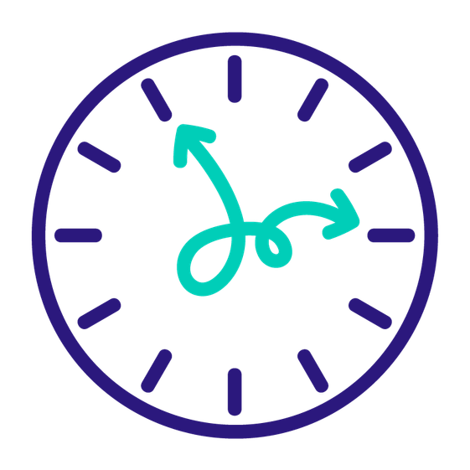



Squiggly Careers are now everyone’s reality
85%
When organisations support people to ‘Squiggle
& Stay’, employees
stay for twice
as long
of the jobs that will exist in 2030 haven’t been invented yet
88%
50%
2x
People starting work today will have twice as many jobs over their careers compared to 15 years ago
of employers prefer people with varied skills and experiences versus a traditional career path
of people say that would
leave an organisation
where they can’t progress
in some way

Slide 7

Squiggly Careers are now everyone’s reality
Squiggly Careers increase ownership, opportunities and create a commitment to learning and growing
in an organisation.
Squiggly Careers are now everyone’s reality. People starting work today will have twice as many jobs over their careers compared to 15 years ago and 85% of the jobs that will exist in 2030 haven’t been invented yet.
Growing in a job and career is a significant reason why people stay in organisations. Nearly 50% of people say they would
leave a job that doesn’t offer progression. But flatter organisations with fewer layers mean that progression needs
to mean much more than promotion.
Investing in squiggly careers creates better outcomes for everyone.
Organisations who support people to ‘Squiggle & Stay’ find that employees stay almost twice as long as those
that don’t.
Individuals who take ownership for their careers create more opportunities and increase their relevance and resilience.
It’s time to lose the ladder and help everyone succeed in their squiggly career.

Slide 8
Squiggly Careers Company Toolkit
How to get started
with squiggly careers

Slide 9
How to help people succeed in a squiggly career
There are 3 ways you can get started with squiggly careers
in your organisation:
1. Squiggly career skills
2. Squiggly career support
3. Squiggly career structures
To create momentum with squiggly careers in your company, we’ve got three ideas for action and tools
to help you get started.
1. Skills
Run a Skills Sprint
Build an everyday learning habit with our guide to running
a skills sprint for teams
2. Support
Improve career conversations
Have a great career conversation using our
Career Canvas
3. Structures
Help people Squiggle and Stay Simple experiments
and prompts to help you reimagine retention

Slide 10
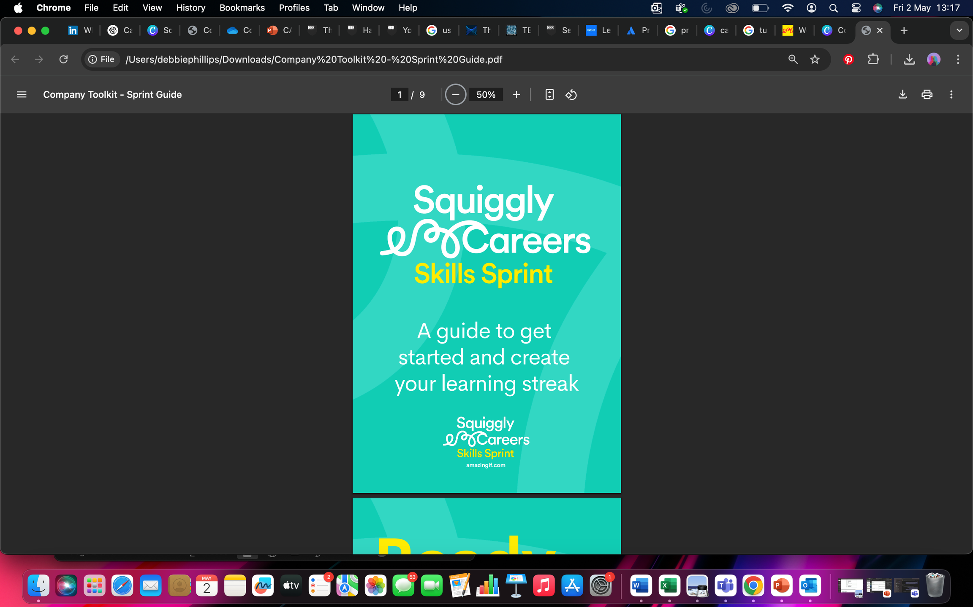
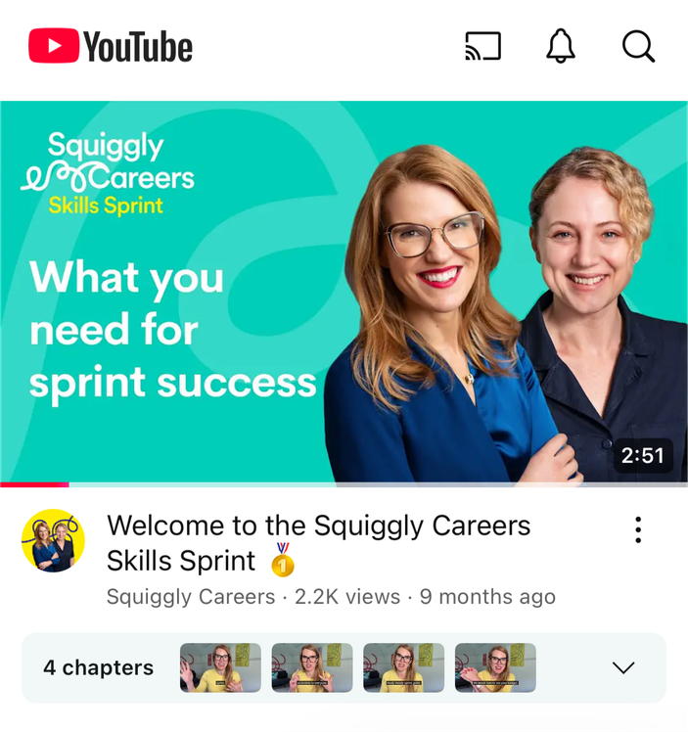
How to develop squiggly career skills
Skills sprints
Not having enough time is the biggest barrier for most people when it comes to career development.
A skills sprint can create momentum and energy to encourage everyone to learn in a way that’s easy to add in to their day.
Idea for action
YouTube Playlist
Our skills sprints take less than 10 minutes a day and are designed for individuals or teams to learn together.

Slide 11

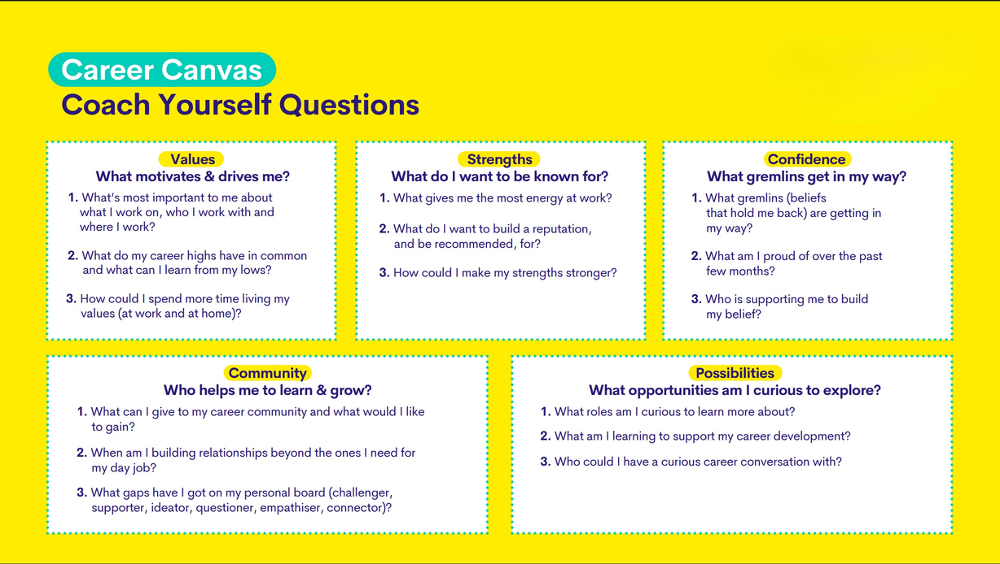

How to support squiggly career conversations
Career conversations
Free tool: Career Canvas
Career conversations are a moment that matters for people’s motivation and progression.
A useful career conversation creates clarity and prompts people to take positive action to grow in their roles and explore opportunities for the future.
Idea for action
Podcast
Our career canvas tool uses coaching questions to provide individuals and managers with a framework for having a career conversation

Slide 12



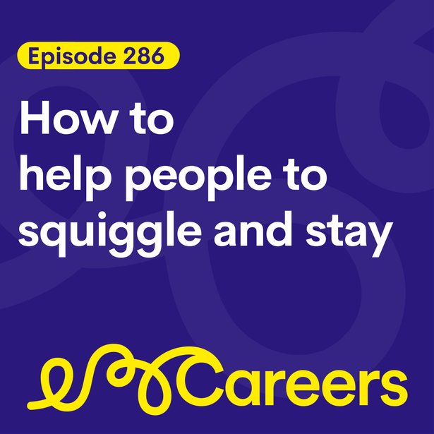



How to create squiggly career structures
Squiggle & Stay
Squiggle & Stay Experiments
Ladder-like career development limits people’s opportunity to progress and results in employees being more likely to leave.
Unlocking progression possibilities that go beyond promotion gives people the ability to personalise their career development.
Squiggly job specs
Squiggly safari
Move mentoring
Idea for action
Podcast
Career moments
Progression projects
Squiggly stories
Use our Squiggle and Stay Playbook for inspiration to unlock progression possibilities in your company.

Slide 13
Squiggly Careers Company Toolkit
Links & logos

Slide 14







Links & logos
Careers Past
Careers Present

Slide 15

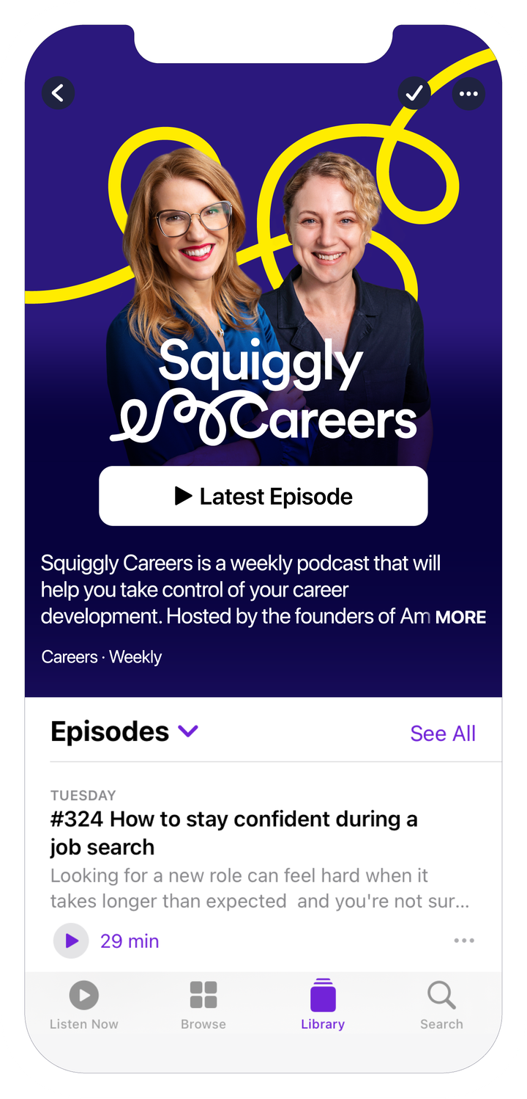
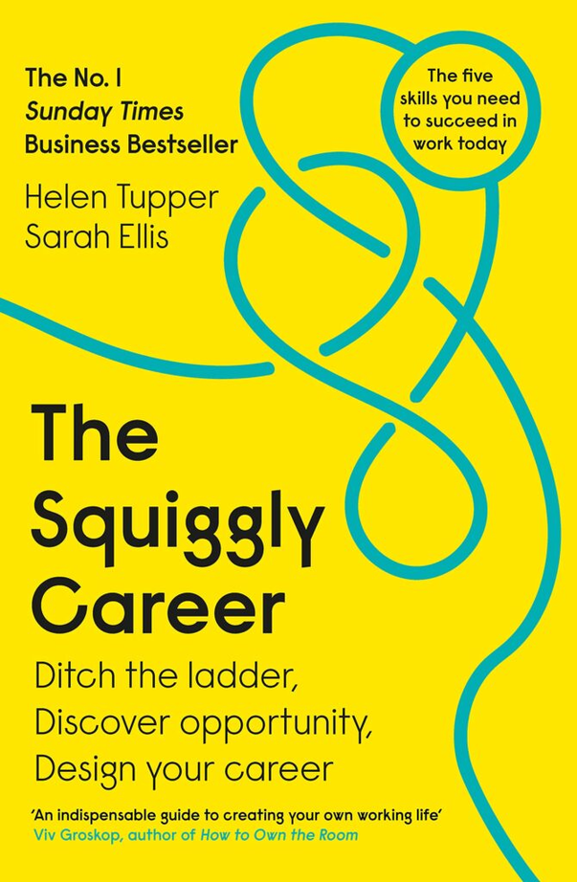
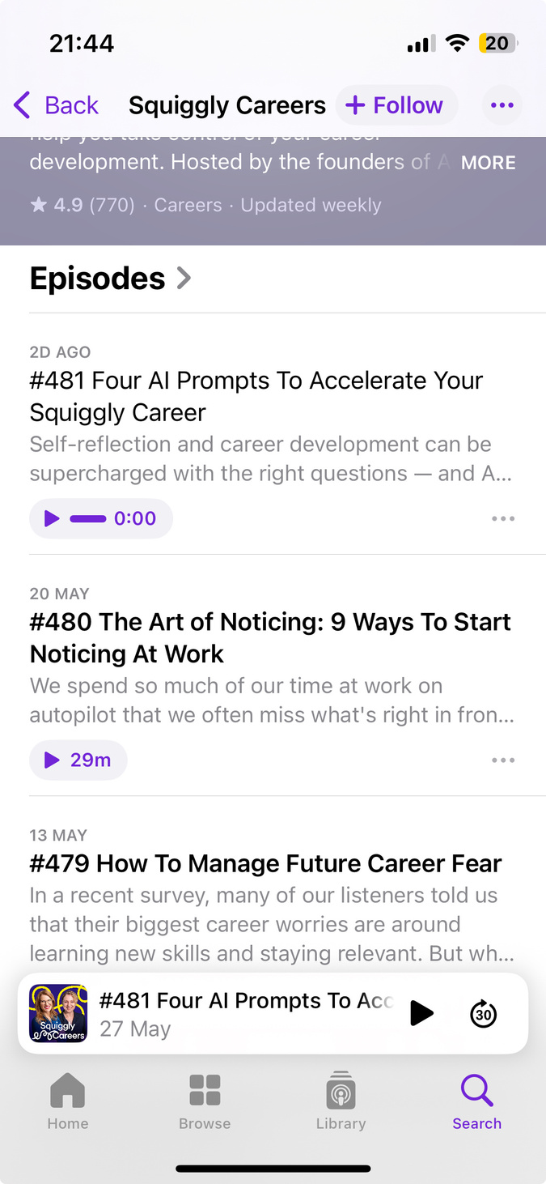
More Squiggly Careers support
Newsletter
Podcasts
Books
How to manage future career fear, learn from mistakes and find the squiggly support you need.
This week is ‘Learning at Work Week’. Sometimes it feels like there is a week or a day everything (did you miss last week’s Lost Sock Day... I’m not joking, it’s a thing!) Anyway, we think having a week dedicated to learning at work is useful. If we don’t learn at work, we risk getting left behind with our development and that’s not going to help anyone succeed in their Squiggly Career.
Time remains one of the biggest challenges and unfortunately we can’t magic up more. What we can do it make sure that when we learn, our insights are more likely to last. One of the most effective ways to achieve this is to learn with others. We’ve got some good ideas for how to do this in this week’s podcast (fancy trying a game of ‘skills snap’ in your next team meeting?) and we’ve also got some events coming up which will help you learn too. 👇

Slide 16

How can we help?
We’re on a mission to make careers better for everyone. Get in touch to let us know how else we can help.
helenandsarah@squigglycareers.com
squigglycareers.com

Slide 17

References
People starting work today will have twice as many jobs over their careers compared to 15 years ago
https://www.thetimes.com/article/thousands-of-over-50s-are-choosing-to-embark-on-a-second-career-in-an-entirely-new-field-s58wqhht3
85% of the jobs that will exist in 2030 haven’t been invented yet
https://www.dell.com/en-us/dt/perspectives/realizing-2030.htm
When organisations support people to ‘Squiggle & Stay’ employees stay for twice as long
https://learning.linkedin.com/content/dam/me/business/en-us/amp/learning-solutions/images/wlr-2024/LinkedIn-Workplace-Learning-Report-2024.pdf
Nearly 50% of people say that would leave an organisation where they can’t progress in some way
https://www.pwc.co.uk/services/human-resource-services/insights/uk-hopes-and-fears-survey.html
88% of employers prefer people with varied skills and experiences versus a traditional career path
https://www.familyfriendlyworking.co.uk/2024/08/04/88-of-employers-prefer-jack-of-all-trades-professionals-over-those-who-follow-traditional-routes/

